Slide 1
Continuous Integration
Authored and Presented by : Cybage Software Pvt. Ltd.

Slide 2
Agenda
  What is Continuous Integration?
  CI Scenario
  Steps of CI Scenario
  Advantages of CI
  Practices to be followed
  Continuous Database Integration
  Continuous Testing as a part of CI
  Continuous Inspection
  Continuous Feedback and CI

Slide 3
What is Continuous Integration
Continuous integration (CI) is a software engineering practice in which isolated changes are immediately tested and reported on when they are added to a larger code base.
The goal of CI is to provide rapid feedback so that if a defect is introduced into the code base, it can be identified and corrected as soon as possible.
CI can be used to reduce the time between when a defect is introduced and when it is fixed, thus improving overall software quality.

Slide 4
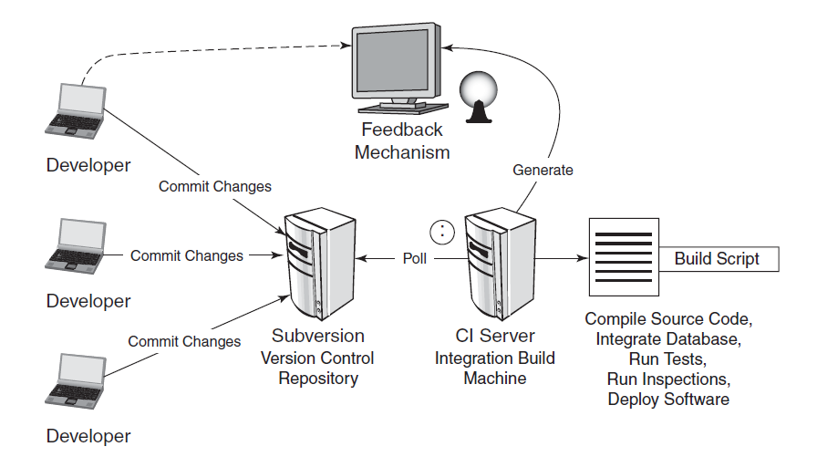
CI Scenario

Slide 5
Steps of CI Scenario
First, a developer commits code to the version control repository. Meanwhile, the CI server on the integration build machine is polling this repository for changes.
Soon after a commit occurs, the CI server detects that changes have occurred in the version control repository, so the CI server retrieves the latest copy of the code from the repository and then executes a build script, which integrates the software.
The CI server generates feedback by e-mailing build results to specified project members.
The CI server continues to poll for changes in the version control repository.

Slide 6
Advantages Of CI
  Reduce risks.
  Reduce repetitive manual processes.
  Generate deployable software at any time and at any place.
  Establish greater confidence in the software product from the development team.
  Enable better project visibility.

Slide 7
Practices to be followed:
  Commit code frequently.
  Don’t commit broken code.
  Fix broken builds immediately.
  Write automated developer tests.
  All tests and inspections must pass.
  Run private builds.
  Avoid getting broken code.

Slide 8
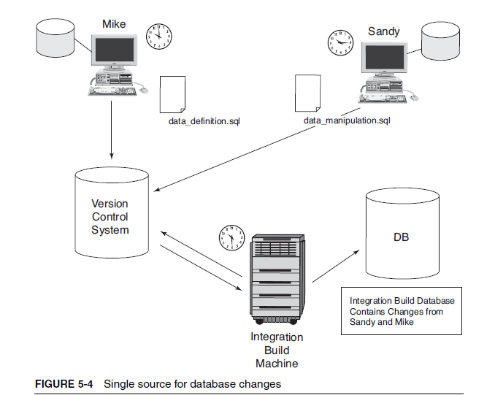
CDBI as a part of CI
Continuous Database Integration (CDBI) is the process of rebuilding
your database and test data any time a change is applied to a project’s
version control repository.
Using CDBI, your database and your source code are synchronized many times a day.

Slide 9
Continued..
Automate database integration.
Use a local database sandbox.
Use a version control repository to share your database assets.
Give developers the capability to modify the database.
Make DBA the part of development.

Slide 10
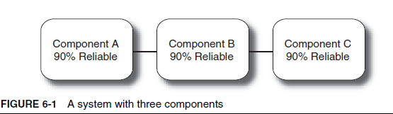
Continuous Testing as a part of CI
Each component in this sample system has its reliability measured
and the values are each determined to be 90%.
The overall reliability of this system is only 73%.

Slide 11
Continuous Testing
Automate Unit Tests: Unit tests verify the behavior of small elements in a software system, which are most often a single class.
We can say unit tests are effective way of debugging.
Automate Component Tests: Component or subsystem tests verify portions of a system and may require a fully installed system or some external dependencies, such as databases, file systems etc.
Automate System Tests: System tests exercise a complete software system and therefore require a fully installed system, such as a servlet container and associated database.
Automate Functional Tests: Functional tests, as the name implies, test the functionality of an application from the viewpoint of a client. These tests are also known as acceptance tests.
Categorize Developer Tests: We can run unit tests every time when someone checks code in, as they don’t take much time to execute, and then schedule periodic intervals to run component tests and functional tests.
We can have different directory structure for source code and tests.

Slide 12
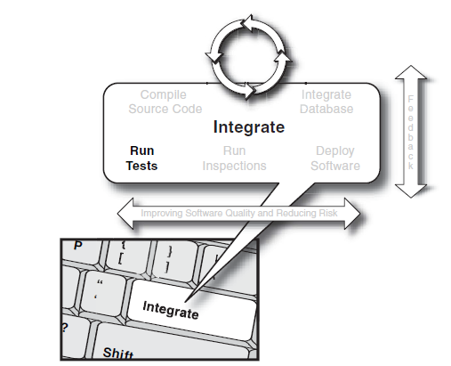
Continuous Testing

Slide 13
Continuous Inspection
Checks the quality of the code.
Reduces the time between a discovery and a fix.
Analyzes the code based on the set of predefined rules.
Reduce Code Complexity.
Maintain organizational standards with code audits: e.g. PMD
Reduce duplicate code.
Assess code coverage : e.g. cobertura, clover etc.

Slide 14
Continuous Feedback and CI
Getting the right information to the right people at the right time and in the right way—CI is the best tool for making this feedback automated, targeted, and real-time (continuous).
  Continuous feedback devices CFDs typically notify project stakeholders of the success or failure of a build, but they also can notify them of other issues.
  For example, a CFD can notify specific parties that a threshold has been exceeded (e.g., code duplication has gone over a specified percentage).

Slide 15
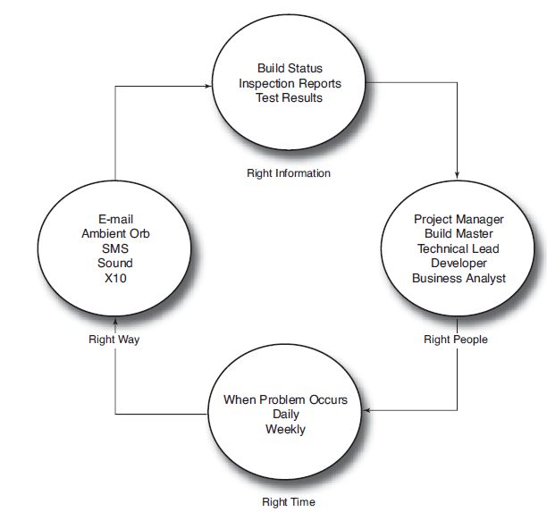
Continuous Feedback and CI

Slide 16
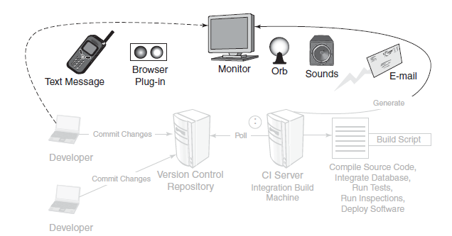
Continuous Feedback Mechanisms

Slide 17

Any questions?

Slide 18
Thank You!

